Slide 1

Introduction
CSCI 232 Databases Lecture 1
By Ariel Avshalom

Slide 2
Why collect data?

Slide 3

What is data?
Data, in the most formulaic definition is:
A set of entities (like a person or a cat) with attributes
It is a method of modeling just about anything
Modeling is a naturally limiting operation of converting an entity into data

Slide 4
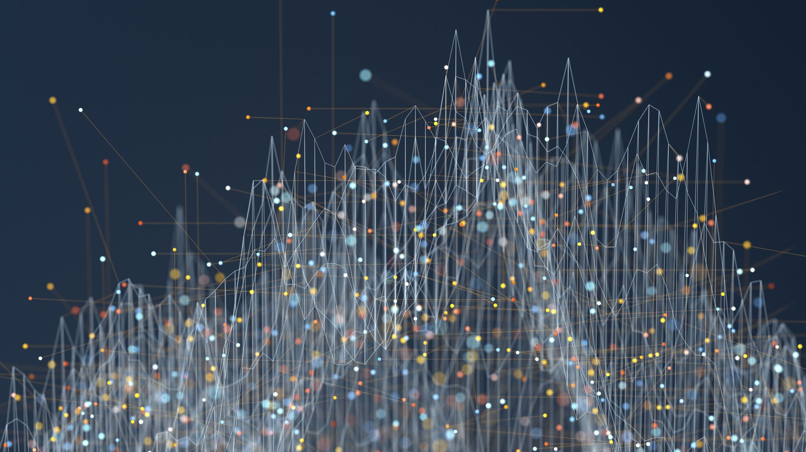
Reasons companies collect data
To earn more money
To reduce costs

Slide 5

Pizza Pizza
Take this as an example:
There is a huge pizza company that has many stores
They could run a trial where they reduce the amount of cheese and see if that affects sales
If sales don’t decrease, they just saved a whole lot of money
Alternatively, they could use more quality products and see if there is an increase in sales

Slide 6
Other reasons to collect data
Almost all applications of data (including that charming buzzword Big Data) have to do with making money
But there are also other use cases

Slide 7

Policing
How do you think the police actually solve crimes?
Let me paint you an interesting story…
All I can say is ¯\_(ツ)_/¯

Slide 8
What is a database?
A database is a place to collect and store data
We use SQL to create, modify, and query data from almost all databases in use today
All data on a database that runs with SQL is relational, meaning that it

Slide 9
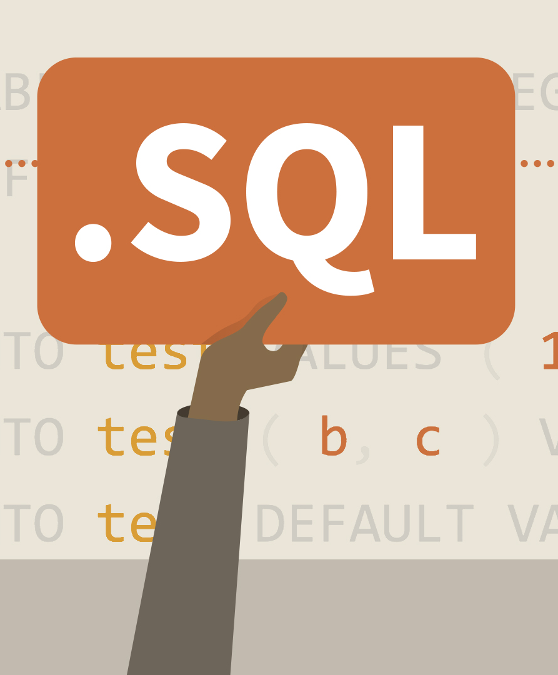
What is SQL?
SQL stands for sequential query language
The main components of the language are CRUD operations or:
Create (a table, database or row in a table)
Read (select data and view it in useful ways)
Update (change a row in a table)
Delete (delete a row in a table)
In real life, you don’t update or delete data and you almost never create tables.
Most of the work is massaging data with read operations to get sweet, sweet information.

Slide 10
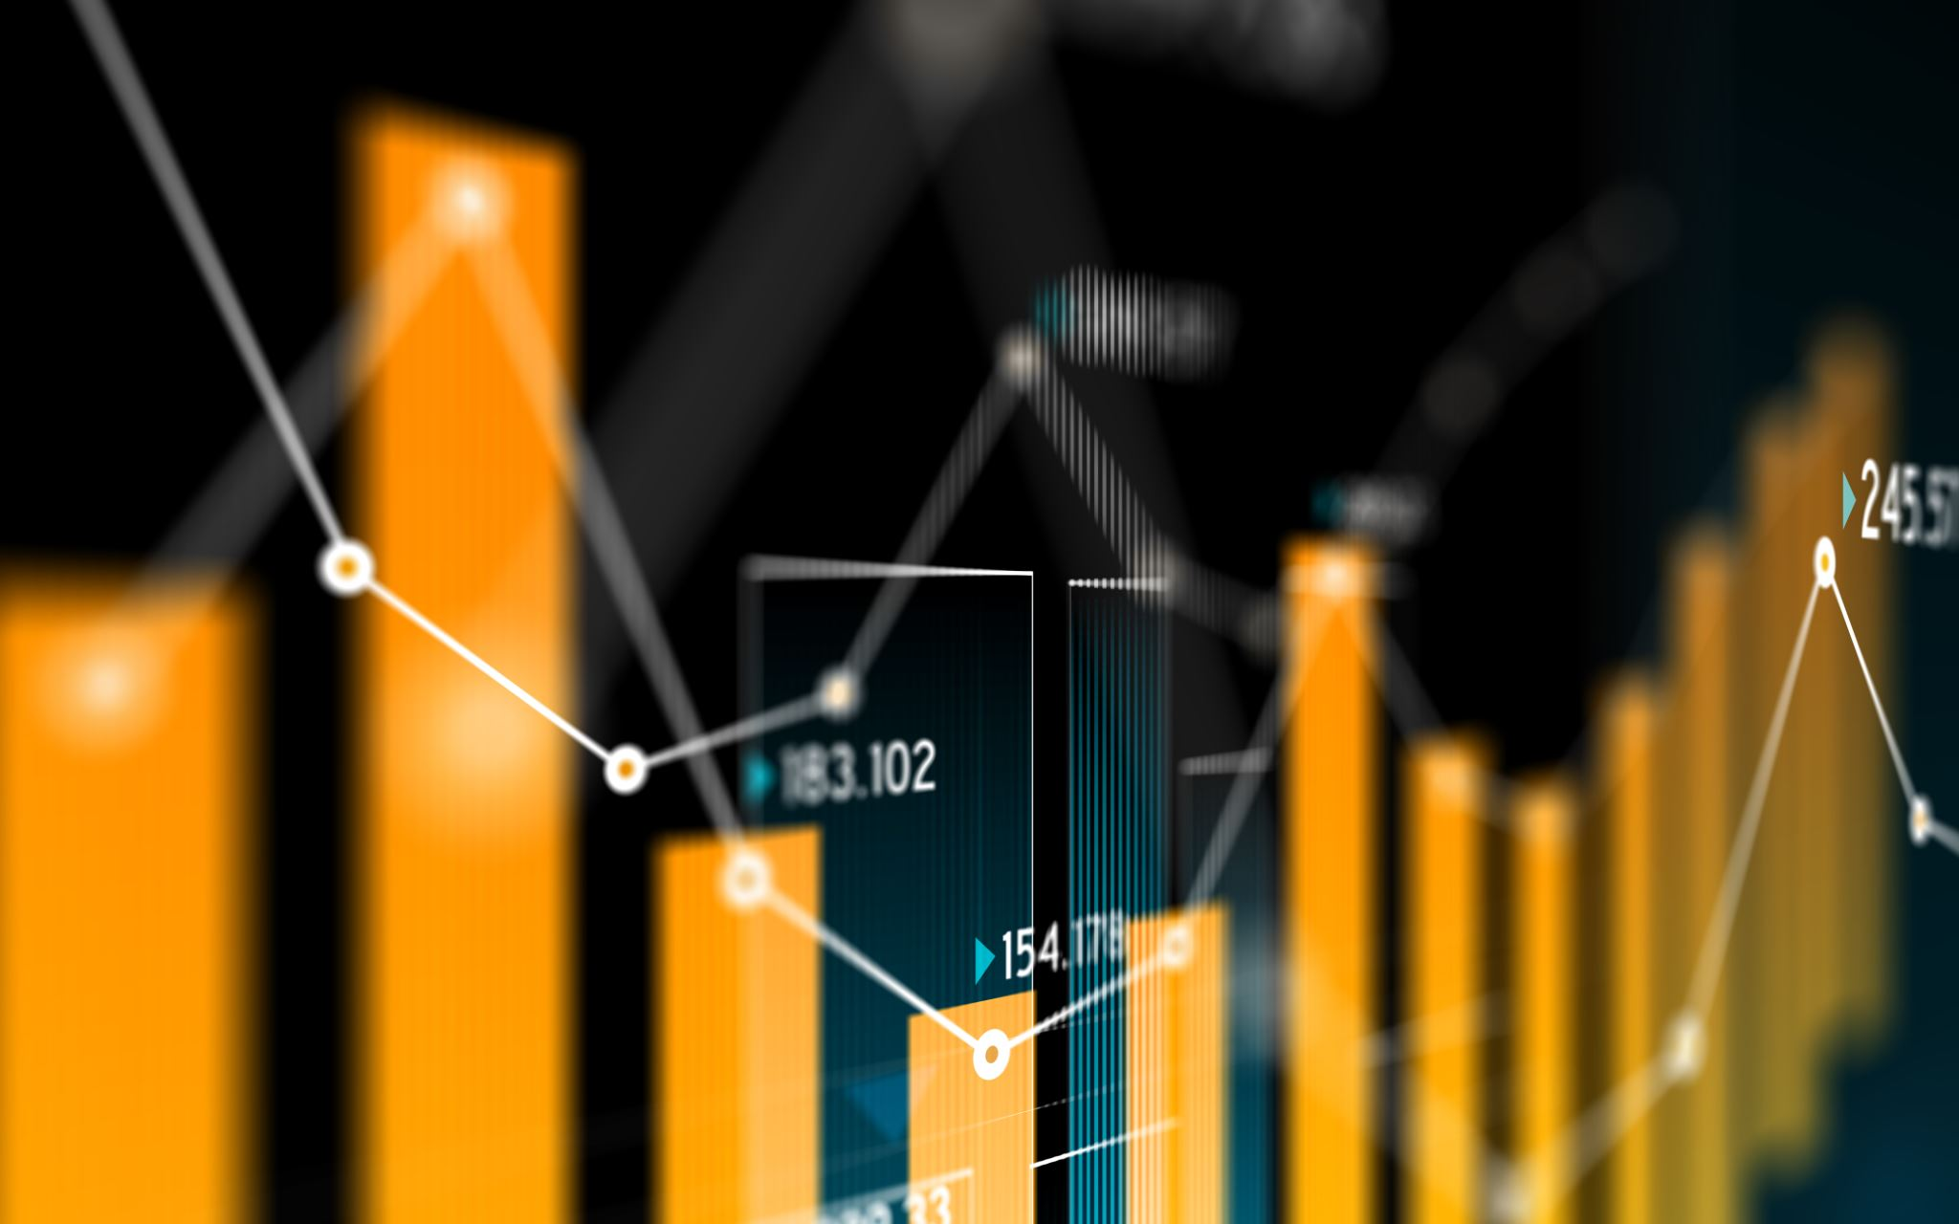
Information?
Information ≠ data
We can have billions of gigabytes of data and have no information
Example: the expansion of π. Somewhere in the expansion of π, this class is going on, but there is no value in that data, because the sequence is random (supposedly).
Our goal is to extract information from our data. Information could be priceless, while data in and of itself could be worthless.

Slide 11
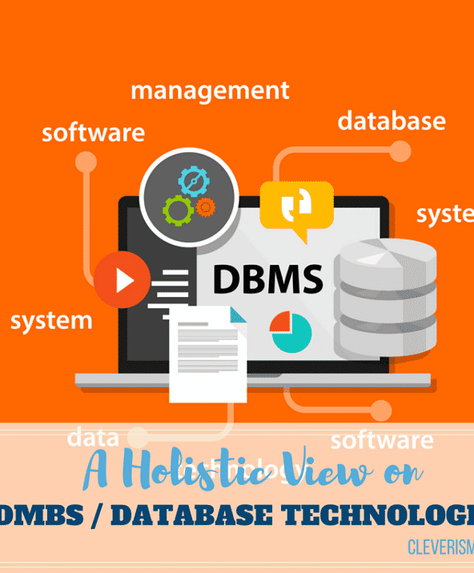
Ok: SQL, Data, how do we do it?
We use a DBMS or database management system in order to communicate to a database with SQL
(NOTE: it is totally possible to create your own flavor of SQL but most people don’t do that)
Some DBMS’ out there are
Oracle
MySQL
PostgreSQL – what we’ll be using in this class

Slide 12

Why use Postgres?
Postgres is:
Opensource
Used by many companies
Is one of the best free solutions available

Slide 13
How to install Postgres on your computers
Hunter recently added Postgres to the computers at the CS Lab
I would prefer that you all install Postgres on your computers
We’ll now try to cover how to install Postgres on Windows and Mac (if time permits)

Slide 14

Important definitions:
Tuples – structured data like a row in a table
Tables: otherwise known as relations are lists of tuples
To define a table, we need table name, table fields and a primary key

Slide 15
Caution is your friend
In real life, always make sure you have a copy of your data or a rollback feature before you try doing fancy footwork in SQL

